Slide 1
Image Processing World
Intro to Edge detection

Slide 2
Image processing
Edge detection
Canny Edge detector
References

Slide 3
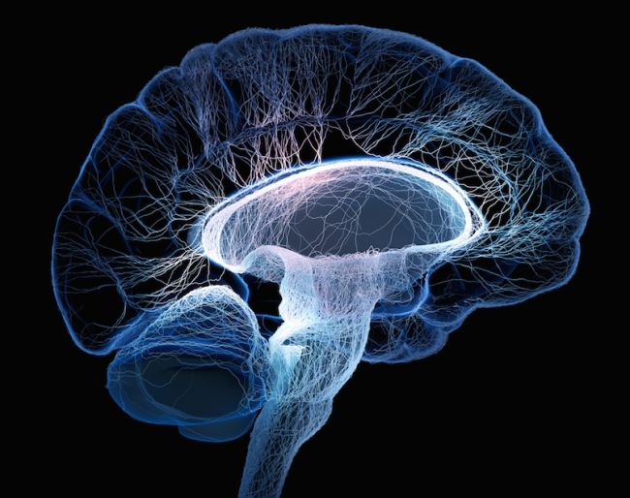
Human Brain
Our brain crave to visual communication.

Slide 4

Image Processing
enhance
extract
analyze

Slide 5
Purpose
Application

Slide 6
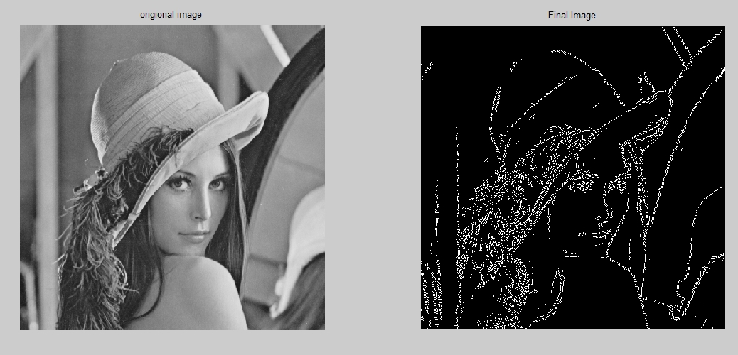
Edge detection
Edge detection is an image processing technique for finding the boundaries of objects within images. .Edges typically occur on the boundary between two different regions in an image.

Slide 7
Basic idea:
Look for a neighborhood
with strong signs change
12 | 90 | 89 | 86 | 87 | 82
10 | 12 | 88 | 85 | 83 | 84
9 | 15 | 12 | 84 | 84 | 88
12 | 14 | 10 | 82 | 88 | 89
11 | 17 | 16 | 12 | 88 | 90
10 | 16 | 15 | 17 | 89 | 88

Slide 8
extracted Important features
Object detection

Slide 9

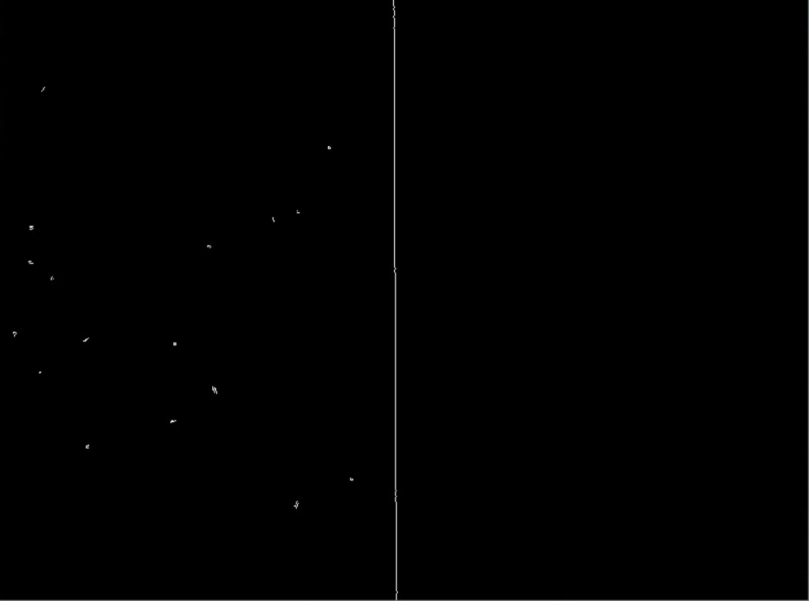

Slide 10
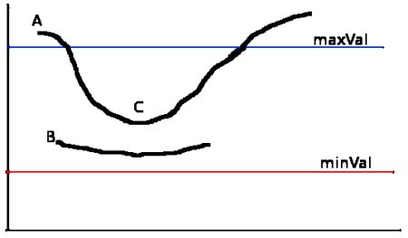
Canny
Gaussian Filter
Compute the gradient
non max suppression
Threshold

Slide 11


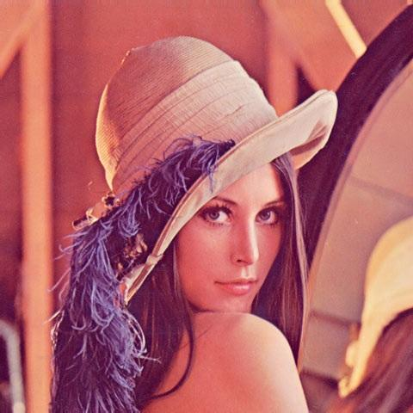
original
grayscale
Gaussian

Slide 12
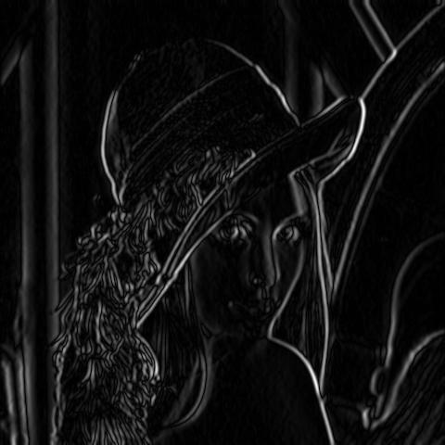
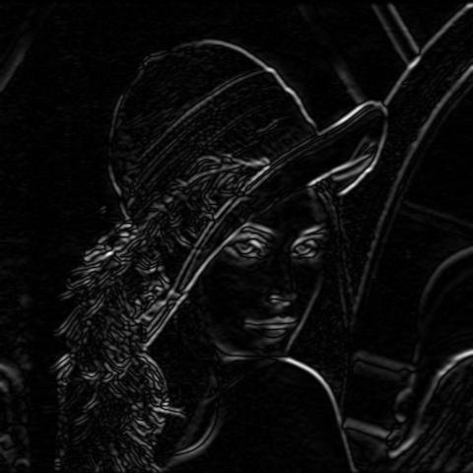
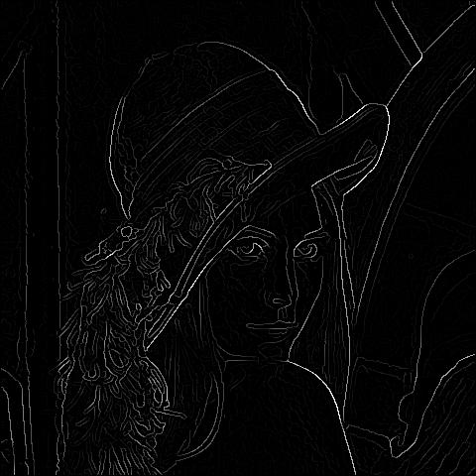
Gradient x
Gradient y
non-max

Slide 13
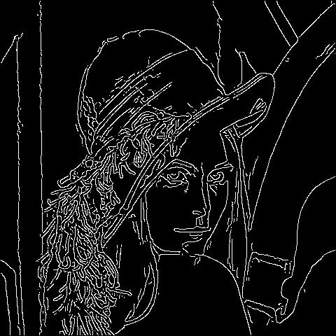
Threshold

Slide 14
import cv2
import numpy as np
img = cv2.imread('img/edge.jpg',0)
edges = cv2.Canny(img,100,200)
cv2.imshow('pic1', edges); cv2.waitKey(0); cv2.destroyAllWindows(); cv2.waitKey(1)

Slide 15


Slide 16
Contribution
A picture is worth a thousand words that why we need image processing
Edge detection is first thing come when you want to detect objects

Slide 17
References
https://www.columnfivemedia.com/why-your-brain-loves-visual-content-infographic
https://killervisualstrategies.com/blog/how-our-brains-are-hardwired-for-visual-content.html
https://sisu.ut.ee/imageprocessing/book/1
https://campus.datacamp.com/courses/image-processing-in-python
https://www.youtube.com/watch?v=QMLbTEQJCaI&t=143s
https://opencv-python-tutroals.readthedocs.io/en/latest/py_tutorials/py_imgproc/py_canny/py_canny.html
https://www.mathworks.com/discovery/edge-detection.html
https://www.cse.unr.edu/~bebis/CS791E/Notes/EdgeDetection.pdf
https://www.youtube.com/watch?v=-pmUQ6RSejQ
https://classroom.udacity.com/courses/ud955/lessons/3186188679/concepts/32337687770923#
https://docs.opencv.org/master/d7/de1/tutorial_js_canny.html

Slide 18
References
https://www.youtube.com/watch?v=CGfXCkHNemo&t=260s
https://www.quora.com/What-are-the-applications-of-edge-detection
https://datacarpentry.org/image-processing/08-edge-detection/
https://www.youtube.com/watch?v=WgHHmBSrbwE
https://www.youtube.com/watch?v=7mEiTU-XgCo
https://www.youtube.com/watch?v=F3oXk3e11m4
https://www.mathworks.com/matlabcentral/fileexchange/40737-canny-edge-detector
https://www.livescience.com/29365-human-brain.html
https://www.slideshare.net/NarayanChakraborty1/canny-edge-detection-88108266
http://justin-liang.com/tutorials/canny/#gaussian
https://www.cio.com/article/3496611/qld-deploying-new-facial-image-processing-for-driver-licences.html

